Slide 1
DOCKER ENGINE

Slide 2
COMPONENTS OF DOCKER ENGINE
DOCKER DAEMON
DOCKER ENGINE REST API
DOCKER CLI

Slide 3
1.DOCKER DAEMON
Background process that manages docker images, containers, network and storage volume.
They listen to API request and processs them.

Slide 4
2. DOCKER ENGINE REST API
REST API are used by applications to interact with docker daemon.
It can be accessed by HTTP client.

Slide 5
3.DOCKER CLI
CLI – command line interface
It is used to client for interacting with docker daemon.

Slide 6
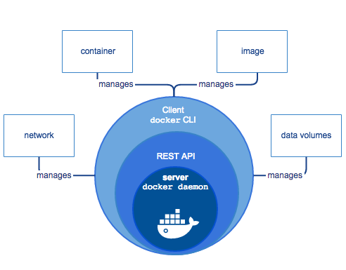
DOCKER ENGINE

Slide 7
WORK FLOW
Docker client talks to the Docker daemon.
And performs the heavy lifting of the building, running, as well as distributing our Docker containers.
Both the Docker client and daemon can run on the same system.
Using a REST API, the Docker client and daemon, communicate over a network interface.

Slide 8
THANKYOU !!
BY
SHAFIUR RAHMAN A

